Slide 1
Empower SQT GUI rewrite
High level design doc

Slide 2
Abstract
A program interface is very important. It links the user to the features of the program. A GUI should be simple to understand learn, appealing to the eye.
This pilot project aims to investigate the feasibility of complete decoupling of the backend from the frontend of the program

Slide 3
Contents
Why SQT
Front end considerations
Back end considerations
High level backend design
Low level SQT API
Mid layer communication protocol
Why HTTP
Why JSON
Frontend examples
Backend
Conclusions

Slide 4
Why SQT
SQT is a very simple program. It has a very limited amount of features
Separating backend from frontend should be easy and fast. A good candidate for a pilot project
SQT is one of the first programs the user comes in contact. If it has an appealing interface, it would give the user the first 5 seconds of good impression ( what counts most ).

Slide 5
Front end considerations
Frontend should keep pace with GUI trends
Frontend should be able to use new technologies that might emerge in the future
Front end implementation should be independent from backend. Designers should work in the environment they are best used to. It would be the best for the company to find designers based on their UI skills and not programming skills.
Implementing a new frontend should not require changes on the backend
Front end should be available for multiple platforms
Implementing new frontend in parallel with old one should be possible

Slide 6
Back end considerations
Should not rely on technology that might get replaced in the future ( OS specific API .. )
Should rely on high level of API coming from Empower
Should provide a high level and commonly known communication protocol
Should be scalable when providing a service ( not for SQT )
Should be able to provide service to multiple users at once ( not for SQT )

Slide 7
High level backend design
Multi layer encapsulation
HTTP API
Client ( GUI )
SQT API
Empower API

Slide 8
High level backend design
Communication between modules
Empower API
ATL containers
SQT API
Low level data container
JSON formatter
HTTP server

Slide 9
Low level SQT API
Exposes 4 features :
Is a node capable of performing IQ/OQ/OQMVM ?
Restore SQT projects from CD
Provide a list of nodes Empower could perform SQT functionality
Perform IQ/OQ/OQMVM for one or more nodes

Slide 10
Mid layer communication protocol
Using AFX containers might limit us encapsulating SQT backend into C# or other language projects
Protocol should be extendable without changing specification
Should support sessions
Should support encryption
Should support compression
Should have small overhead
Should be parsable by multiple languages
Should not depend on platform
Should not depend on character set encoding
Should not depend on data type bitcount
Support for data iterator even for dynamic length content
Internally developed library means continuous support and changeable standard

Slide 11
Why proprietary mid layer protocol
Gets support from start to the end
It can have all the features we need
Implementation quality depends on company investment
Restrictions can be removed
Documentation can be maintained

Slide 12
Why not proprietary mid layer
Company does not have to invest resource in it
Might have better architectural design
Community based projects can gather good ideas
Automatically gets updated for new technology making it better over time if there is support for it
Good projects automatically get long term support
Possible extensions
Possible helper tools

Slide 13
Why HTTP
Provides full separation of BackEnd from FrontEnd
Decouples frontend platform from backend platform
Has a wide range of helper libraries
Has a wide range of tools
Can be scaled. It supports caching / proxy / balancing servers
Wide range of languages has support for it
Easy to parse and implement
Firewalls usually allow communication to pass through without special configuration
Can implement sessions on it
Can implement encryption on it
Support for certificates for trusted communication between client server

Slide 14
Why not HTTP
Large overhead
Usually high latency
Not optimized for raw data communication
Might get blocked by firewall
Backend must be run as service. Consumes resource even if not used.

Slide 15
Why JSON
Smaller overhead than XML
Widely supported by multiple languages
Easy to implement parser
Supports data lookahead without parsing full content
Humanly readable. Easy to debug
Adding new structure types are supported by default
Easy to serialize

Slide 16
Why not JSON
Large overhead for binary data
Binary data must be encoded
Nested structures are hard to read
Parsing is slower than using structures / packets

Slide 17
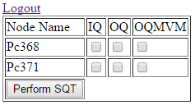
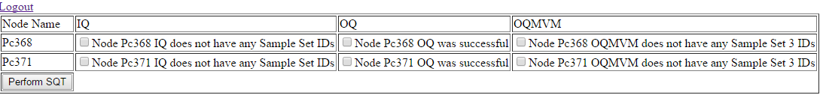
Frontend examples
HTML + PHP frontend implementation

Slide 18

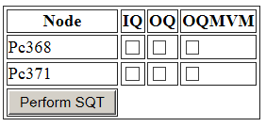
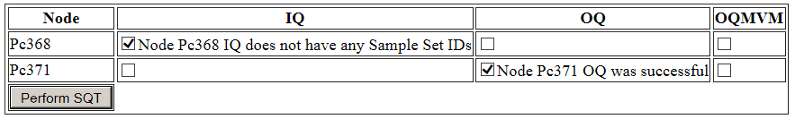
Frontend examples
HTML + Javascript frontend implementation

Slide 19

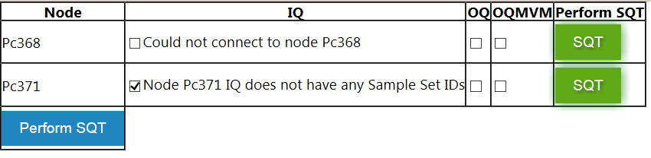
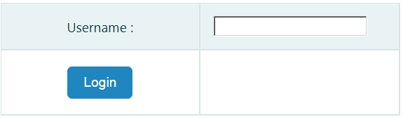
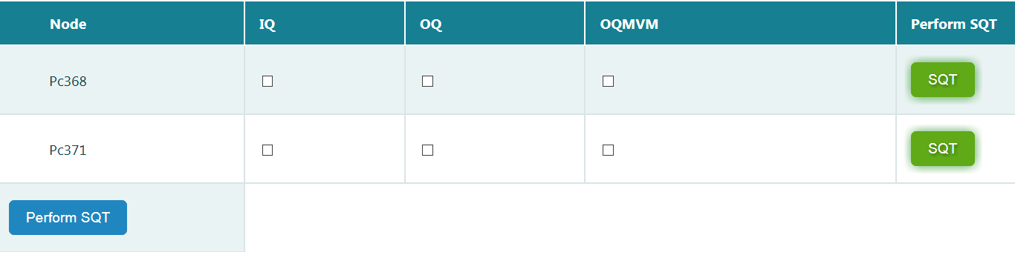
Frontend examples
HTML + Javascript frontend with different styles applied

Slide 20
Conclusions
Adding new styles to frontend is very fast.
Frontend is no longer platform constraint. It can run on Windows, mobile, Linux…
Separating backend from frontend was almost as hard as rewriting backend
It’s possible to separate fully the backend from frontend to be able to use most GUI technologies
If other parts of Empower would be to use frontend-backend separation, a step by step approach would be best. Empower has multiple processes that could be rewritten one by one.

